Slide 1
epiRL: a reinforcement Learning agent to facilitate Epistasis detection
Meeting 6/5/2020

Slide 2
Objective
Modelling epistasis as a One-step Markov decision process
State is a latent representation of the genome data
Action space are all the SNP
Reward is an interaction measurement
Using reinforcement learning to discover a set of highly interacting genes
  Not vincolated to a particular order
  Faster than exhaustive search

Slide 3
Multi Locus Interactions studies
Problems
Computational complexity make unfeasible a exhaustive search for higher order
Existing algorithm suppose fixed the interaction order, while that order is unknown in nature

Slide 4
In the Literature
Reinforcement Learning has been an hot topic in last years, gaining attention in resolving different task, from playing Go to ATARI videogames.
There has been no previous work on epistasis detection with RL techniques. This paper open a new path to tackle gene-gene interactions challenge.

Slide 5
Data
In this paper it has been used synthetic dataset generated by GAMETES tool, with the following setting
2-locus dataset
600 sequences for both Case and Control
100 SNPs
For the interacting SNP
  0.2 Heritability
  0.7 prevalence
  0.2 minor allele frequency
I

Slide 6
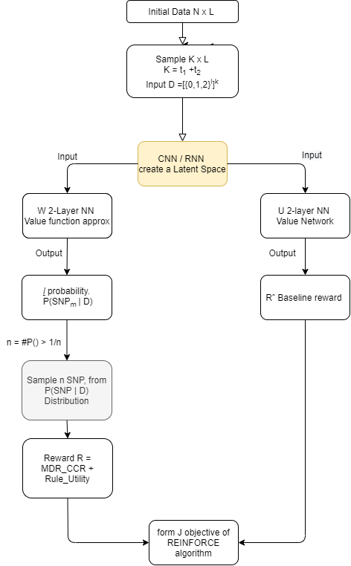
MODEL
In the flow chart we visualize the pipeline of this model

Slide 7


Some note on the elements in the previous pipeline
State for the agent is the latent representation output by a CNN or an RNN
Action space is formed by all the SNPs
R = MDR_CCR + Rule_Utility. It computes measure based on a 2x2 table ( Case-Control ) x (High_Risk - Low_Risk)

Slide 8
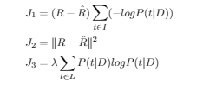
In the training we utilize REINFORCE algorithm in which the objective is J composed by three parts:

Slide 9
RESULT
In the simulated datasets in 50 times, each with a maximum of 5000 iterations it identifies the real PAIRWISE interacted SNPs in 34, with an average iterations of 2260.6 and average time of 22.4. ( In exhaustive search would have been 51s)

Slide 10
Remarks and further works
This paper if fundamentally a Proof of Concept
Seems very promising
Extending on Synthetic dataset with more than 2-order interaction
Verifying performance on real-world dataset
Varying settings anc benchmarking performance with competitor methods

Slide 11
A Deep Learning Approach to Detect SNP Interactions
Meeting 6/5/2020

Slide 12
Objective
Using Deep Learning to detect multi-locus interactions
Associating SNP interactions with risk of diseases
Limited to interactions of second order

Slide 13
Multi Locus Interactions studies
Problems
Curse of dimensionality
Missing Heritability
Computational complexity
Interaction can presents while there are no marginal effect
Detect interactions of order > 2

Slide 14
In the Literature
That paper follows:
Uppu, Suneetha; Krishna, Aneesh; and Gopalan, Raj P., Towards deep learning in genome-wide association interaction studies (2016)
And complete their work by adding a test on a real breast-cancer dataset.
It is part of the field of studies on multi-locus interactions which tries to overcome the limitation of GWAS, most notably the hypothesis that the effects of SNP are only additives.
Switch between single locus detection to detect multi locus interaction

Slide 15
Data
Two data sources have been used in this document
27600 datasets are simulated using GAMETES tool
a real dataset to validate the results found in the earlier paper. The dataset is published from Vanderbilt University Medical centre and is on breast cancer data. It has been used a training sample of 320 000
I was not able to find the dataset at the reported link
I

Slide 16
MODEL
In this paper it has been used a feedforward Neural network, with three hidden layer, all Fully connected, with 50 neurons each. With the following setting:
Input: SNPs
Output: binary classification case/control
Error: Cross-entropy
Optimizer: SGD
Dropout 0.2 input layer and 0.5 to all hidden layer
Activation function: tanh for hidden layers and softmax for output layer

Slide 17
The algorithm is performed 10 times with 10 k-fold Cross validation, every round we select the best model, best input features.
We select the model with
High CVC (cross validation consistency)
Maximum classification accuracy
Low test error

Slide 18
EVALUATION and RESULT
On the breast cancer data the selected model obtain a validation error of 0.294 and a test error of 0.661, very different. That can point to an overfitting issue.
On a performance level, for 320 000 training sample the algorithm run in 17.658 seconds.

Slide 19
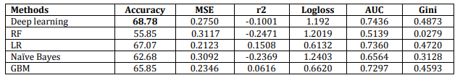

Slide 20
Further improvements and works
Extend to higher level interactions
Using different optimizer and setup
Confused network structure
Dropout at input layer
Limited to detect interaction on SNP with marginal effects
Limited to a small data dimensionality

Slide 21
Detecting Statistical Interactions from Neural Network Weights
Meeting 6/5/2020

Slide 22
Objective
Developing an algorithm that interprets the weights of a Neural Network
Direct interpretation of the weights
Not limited to a specified interaction order
Fast and efficient algorithm
Does not suffer to a high FDR

Slide 23
Multi Locus Interactions studies
Problems
Neural network seen as a black box
Neural network can learn unintended path
Computational complexity make unfeasible a exhaustive search for higher order
Extending beyond additive effects
Interaction can presents while there are no marginal effect
Detect interactions of order > 2

Slide 24
In the Literature
There has been interest in the topic of explaining NN weights with both Direct and Indirect interpretation:
Direct Interpretation
  Input gradients:(Simonyan et al., 2013; Ross et al., 2017; Sundararajan et al., 2017) or Decomposing predictions (Bach et al., 2015; Shrikumar et al., 2017)
  attention-based models (Itti et al., 1998; Mnih et al., 2014; Xu et al., 2015)
  model-specific visualizations (Yosinski et al., 2015; Karpathy et al., 2015)
Indirect interpretation
  post-hoc interpretations of feature importance (Ribeiro et al., 2016)
  knowledge distillation to simpler interpretable models (Che et al., 2016)

Slide 25
Data
In this paper it has been used two data sources
A test suite of 10 function to simulate dataset designed to have mixture of pairwise and higher order interactions
Four real world dataset:
Both binary and classification tasks
  Bike-sharing dataset, 18k observation
  Higgs Boson dataset, 800k observation
  Letter recognition dataset, 20k observation
  California house dataset, 17k observation
I

Slide 26
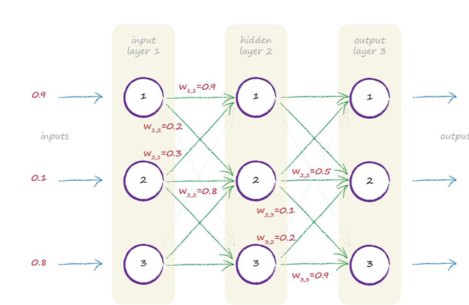
MODELS
In this paper it has been used a feedforward Neural network, with four hidden layer, all Fully connected, with size of 140-100-60-20 neurons respectively. It has been selected the following setting:
Error: MSE for regression and Cross-entropy for classification
Optimizer
L₁ and L₂ regularization to the network weights
Activation function: ReLu for hidden layers

Slide 27
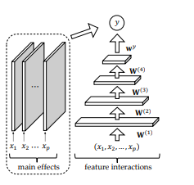
To eliminate main effects from the networks, and avoid spurious correlation, it is proposed a different architecture MLP-M, with a univariate network that combines with the MLP to model away main effect from the network

Slide 28
PROCEDURE
To measure the interaction between SNPs we use the first hidden layer units. For each hidden layer unit, for each order, we select the higher weights according to a metric 𝝁() and the input variables associates with those weights are the candidates .
The selected metric 𝝁() is the minimum of the weights

Slide 29
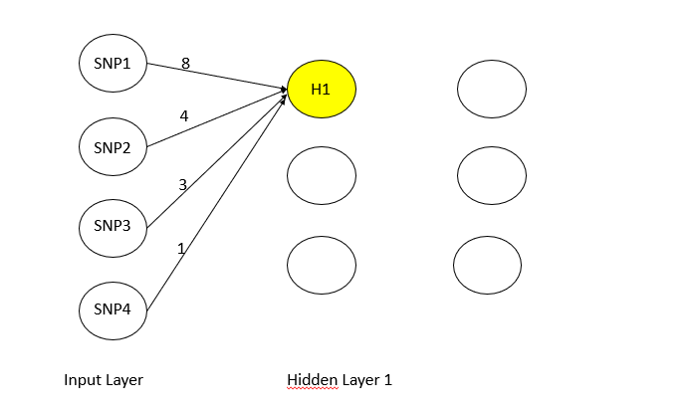
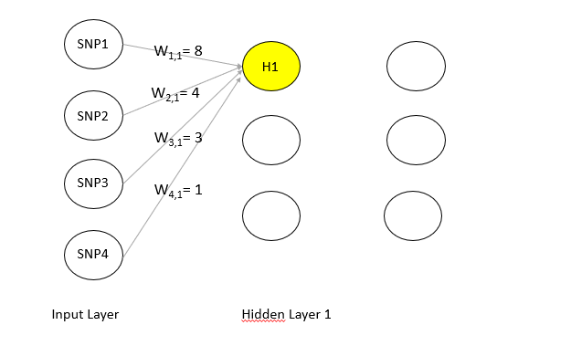

Slide 30
Hidden unit importance
z ^{(l)} = |w^{y} |^{T} |w^{L} | |w^{L-1} | … |w ^{l+1} |
It is computed to weights every neuron importance to the final prediction.
Together with interaction strengths form the importance strength for an interaction in a neuron
ω_{i}(ɪ) = z_{i} ⁽¹⁾ µ(W⁽¹⁾_{(i,ɪ)} )

Slide 31
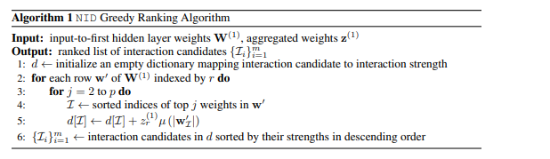
Procedure Overview

Slide 32
Cutoff and selection
In order to predict top k interactions from the candidates set of m interactions we use a GAM with interactions.
c_{K}(x) =∑_{i=1.. P} g_{i}(x_{i}) + ∑_{i=1.. K} g’_{i}(x_{ɪ})
We gradually add top-ranked interactions, increasing K, until GAM performance on a validations set platoon.

Slide 33
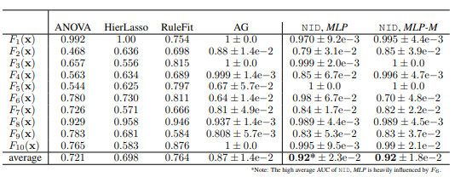
Evaluation and Result
In the following table we can view the AUC for pairwise interactions on synthetic functions.

Slide 34
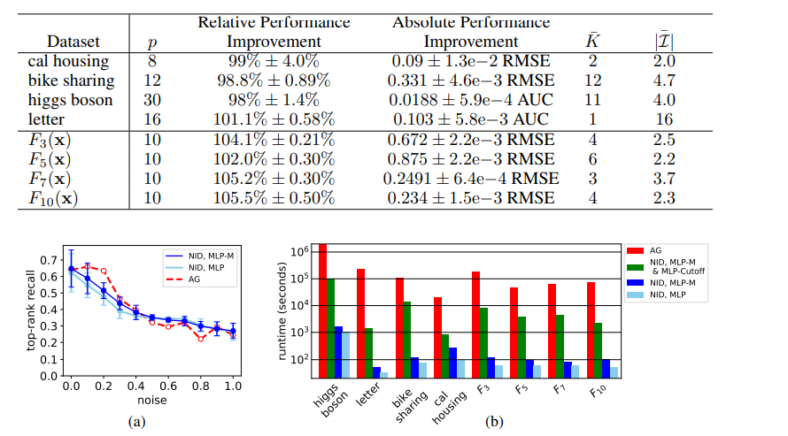
On higher order interaction

Slide 35
Further improvements and works
Addressing limitations on
  Detecting interactions from functions with interlinked variables
  Detect spurious interactions as a result of correlation on feature
Extend to intermediate hidden layers.
A different system to detect hidden unit importance
Exploring NID Greedy algorithm.

Slide 36
An Overview on ML methods, code and results
Meeting 27/05/2020

Slide 37
Objective
Analyzing new papers and current papers on ML tecniques in the epistasis field.
Particular interest in these papers with available code and results
Remark important takeaway from these models.

Slide 38
Current papers
Detecting statistical interactions from NN weights
Authors gave me their python-based code
EpiRL a Reinforcement Learning Approach
Authors gave me their code
They also noted how the results were less-than-ideal
They admitted the paper was primarily a draft

Slide 39
Detecting statistical interactions from NN weights
Python code made available from the authors
They also gave me the private code to reproduce their published results
There is also available a demo notebook very simple

Slide 40
New Papers analyzed
Deep mixed model for marginal epistasis detection and population stratification correctioning genome-wide association studies
  Python Code at: https://github.com/HaohanWang/DMM
Discovering epistatic feature interactions from neural network models of regulatory DNA sequences
  Python Code at https://github.com/kundajelab/dﬁm
Gen-Epi: Gene-based epistasis discovery using Machine Learning
  Python Code at https://github.com/Chester75321/GenEpi

Slide 41
Overview on Deep mixed model
Two data sources have been used in this document
Composed of two component
  CNN Corrector, large Kernel size, for confounding effects
  LSTM Selector + sparse vector attached to input
Results evaluated thourgh different settings and evaluated by a ROC curve
Some issue concerning repo
I

Slide 42
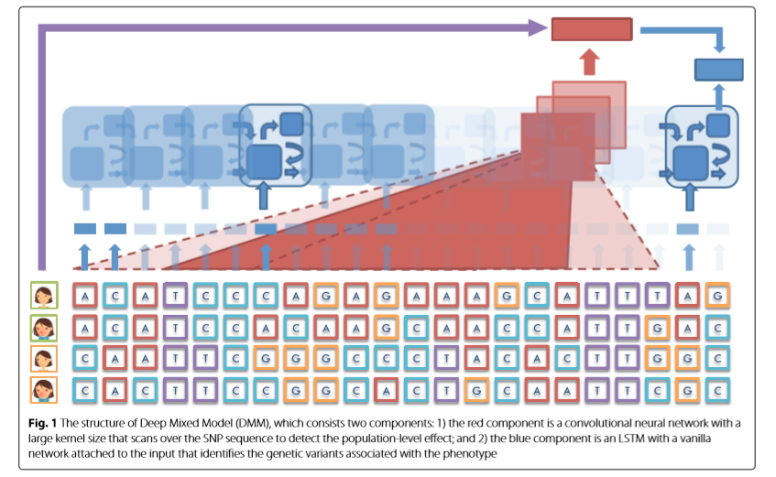

Slide 43
Overview on Discovering epistatic feature interactions from neural network models of regulatory DNA sequences
Compute an Importance Score
Only for pairwise interactions
Mutate randomly a Nucleotide
Search for variation in Importance Score
Biggest variation are taken as Interaction
Available jupyter notebook example
Very structured repo
I

Slide 44
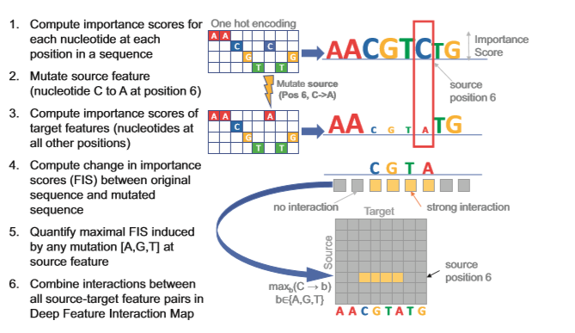

Slide 45
Overview on Gen-Epi: Gene-based epistasis discovery using Machine Learning
Detect only second order epistasis
Two stage model workflow
  Group together SNP in a single gene;
find epistasis within gene
  Pooling together to detect cross-gene epistasis
Structured repo with available examples
I

Slide 46
